Slide 1
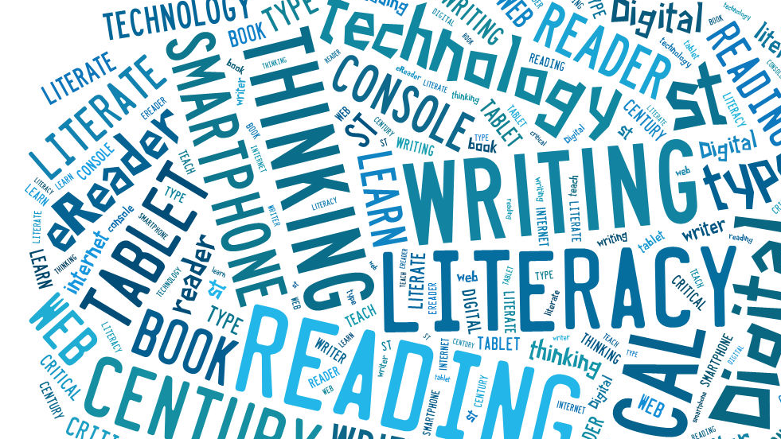
Literacy Toolkit
Hannah Trombley

Slide 2
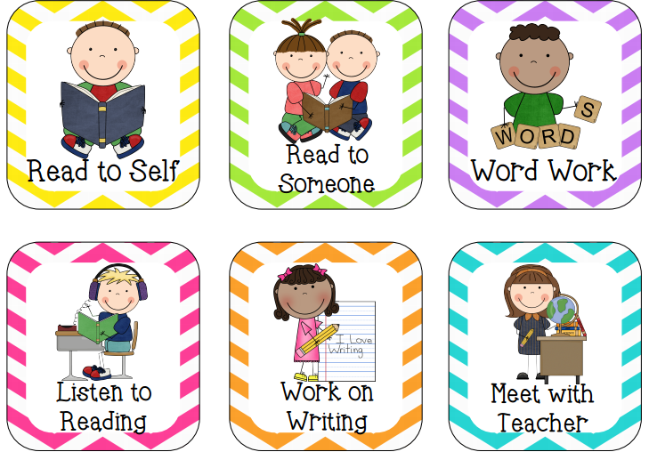
Reading
Some resources I really enjoy to support student reading are: Raz Kids, Reading Power and Daily 5 (as well as literacy circles working with novels)
The reading power model is something I intend to incorporate in my future classroom as well as Daily 5 stations. Throughout each of my practicums, I haven’t witnessed a single student who did not enjoying independent reading or reading to self.

Slide 3
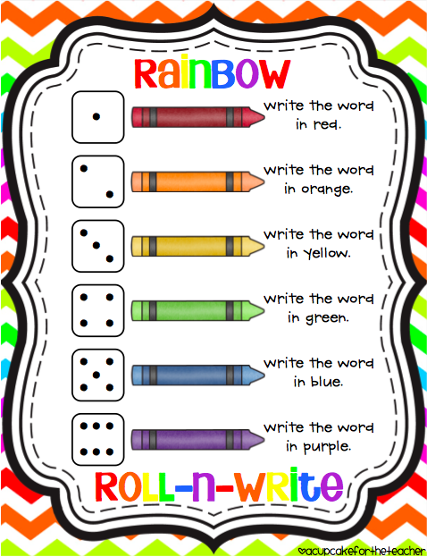
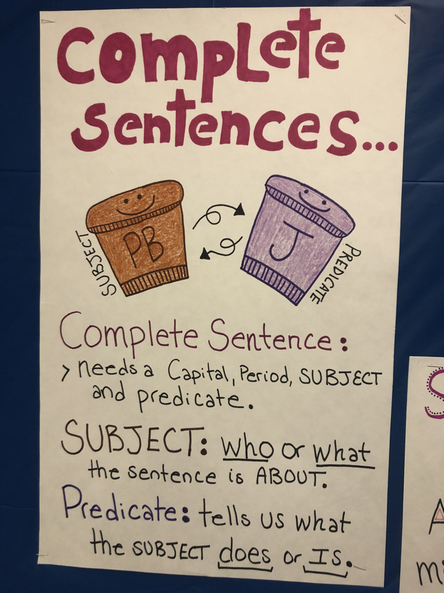
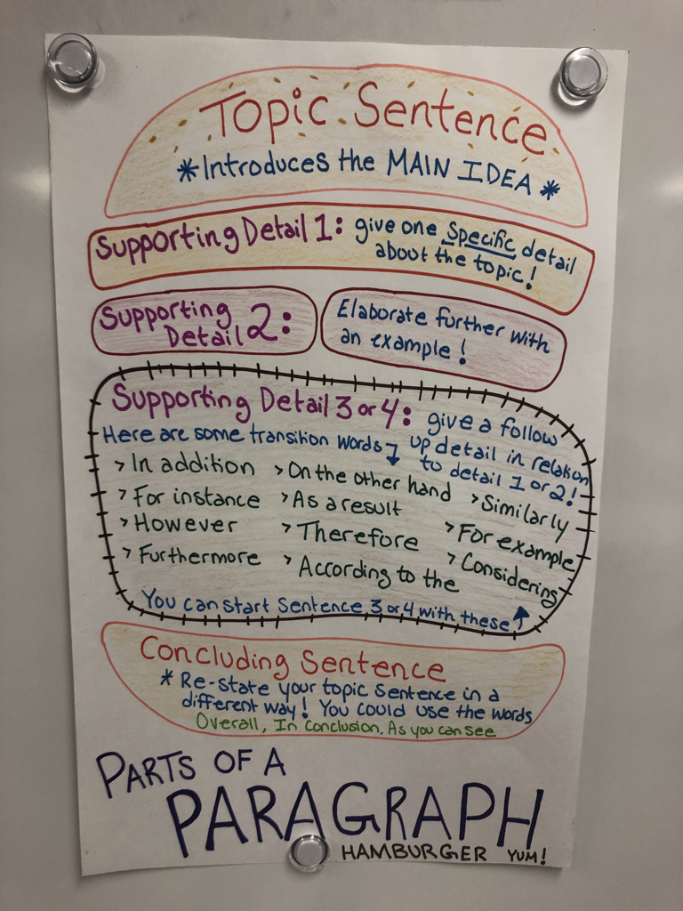
Some resources I really enjoy that support student writing are Writing Power by Adrienne Gear, Daily 5, and Graphic organizers that support writing criteria Writing is usually an area most students struggle with due to a lack of confidence. I intend to incorporate many fun writing activities and choices as well as graphic organizers to go with our learning intentions.
Writing

Slide 4
Oral One of my favorite student resources I have seen for oral learning is the Toobaloo phone while students are reading. Jolly phonics is also a resource I have seen implemented in many primary classes that the students really enjoy! https://www.youtube.com/watch?v=2Xy2e78qxNg Lastly, the Heggerty program is something I have seen implemented in classrooms (during practicum) that students were actively engaged in as well because of the hand and body motions to go along with student learning

Slide 5
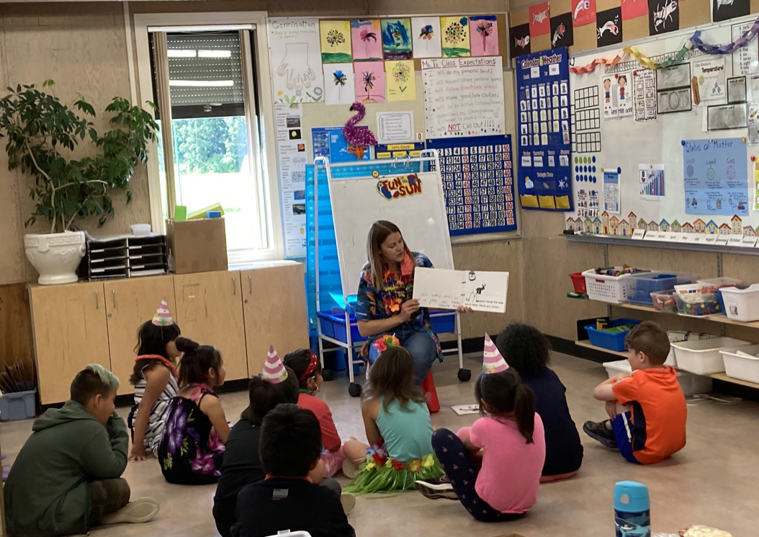
Celebration of Learning
One of my best memories from practicum involved our class making a book called ‘They All Saw A Moose’. Each student made a page to contribute to our classroom book. Once it was complete, we read it together and admired one another's work and individuality. Students were able to read the book to one another during Buddy Reading. It was very popular ☺
More photos from our classroom book can be found on my blog at https://trombley.opened.ca

