Slide 1
Fine Arts Portfolio
Hannah Trombley

Slide 2
Classroom Management Strategies

Slide 3
Attention Grabbers
Teacher says “Ba Da Da Da Da”
Students respond, “Da Da!”
Quiet Coyote ‘Sven’
Hand clapping patterns for students to clap back
Show me your listening ears *Moose antlers*
“Put your finger on your nose if you’re listening” “Put your finger on your mouth if you’re listening” continue until all students are participating
All the above were implemented during my 491 practicum and worked well with my 1/2 students!
An attention grabber I would really like to try is an homage to Queen! Teacher sings “mama” and class replies “OuuuOuuuOuuuu” Here are some other fun examples:
https://www.youtube.com/watch?v=MDpVLJJpj8k

Slide 4
Behavior Management
Some resources I really turned to for support with behavior management in the classroom were:
The MindUp program
Growth Mindset
Calm down strategies for self regulation already implemented by CT (For example: Belly breathing, Bumble Bee breathes, Finger Breathing, Calm down stuffed animals)
Trauma Informed Classroom Strategies (Booklet compiled by Linda O’Neill, Serena George, and Jillian Wagg) I found this resource extremely valuable. https://www.fasdoutreach.ca/resources/all/t/trauma-informed-classroom-strategies-manual
I also purchased the book Breathe Like A Bear by Kira Willey to help students reset during transitions (The students really enjoyed these short mind and body breaks)
Another trick I learned from from my CT was to play Binaural Beats during work time in the classroom for background noise. It kept the students grounded and focused. There are different tones to match their energy!

Slide 5
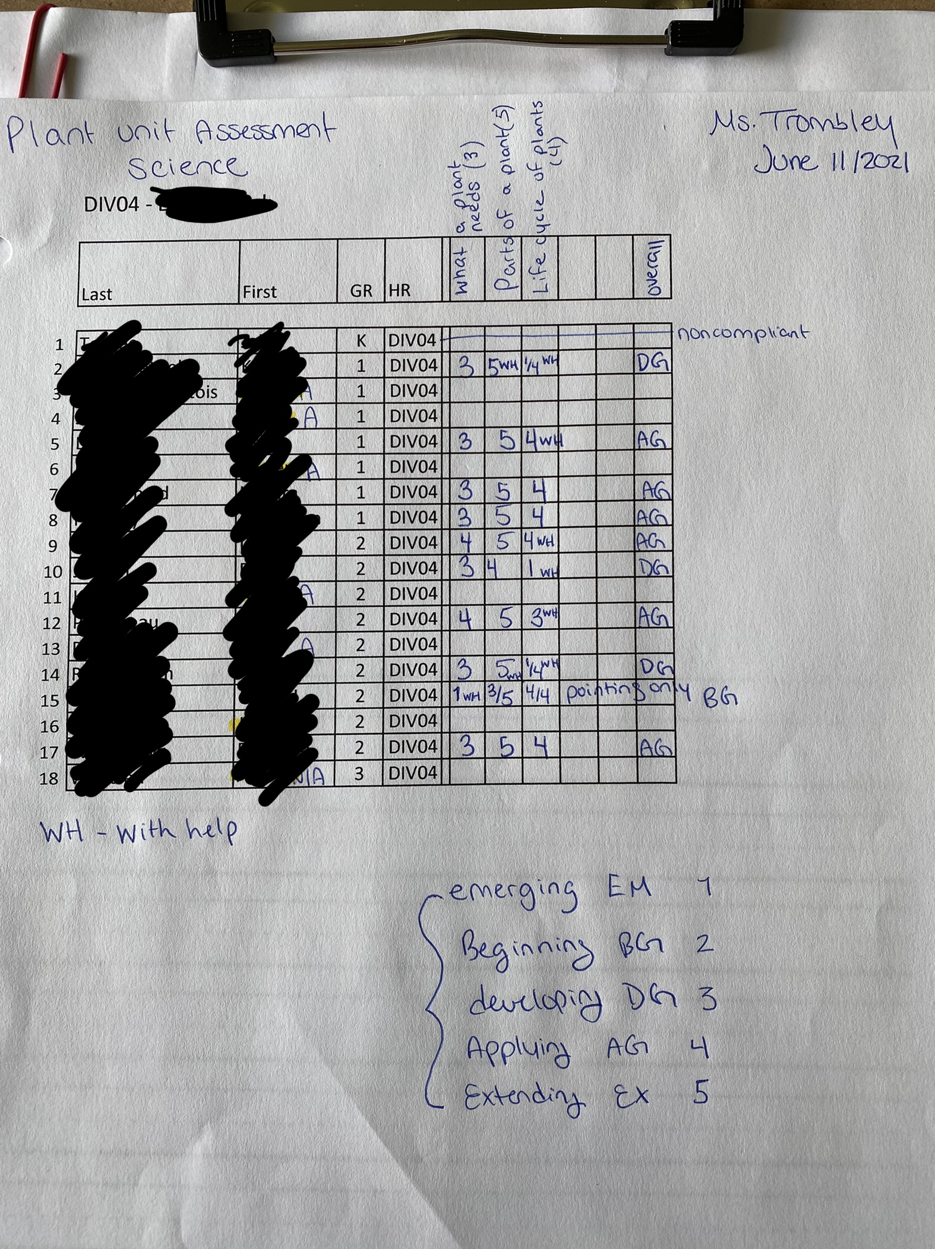
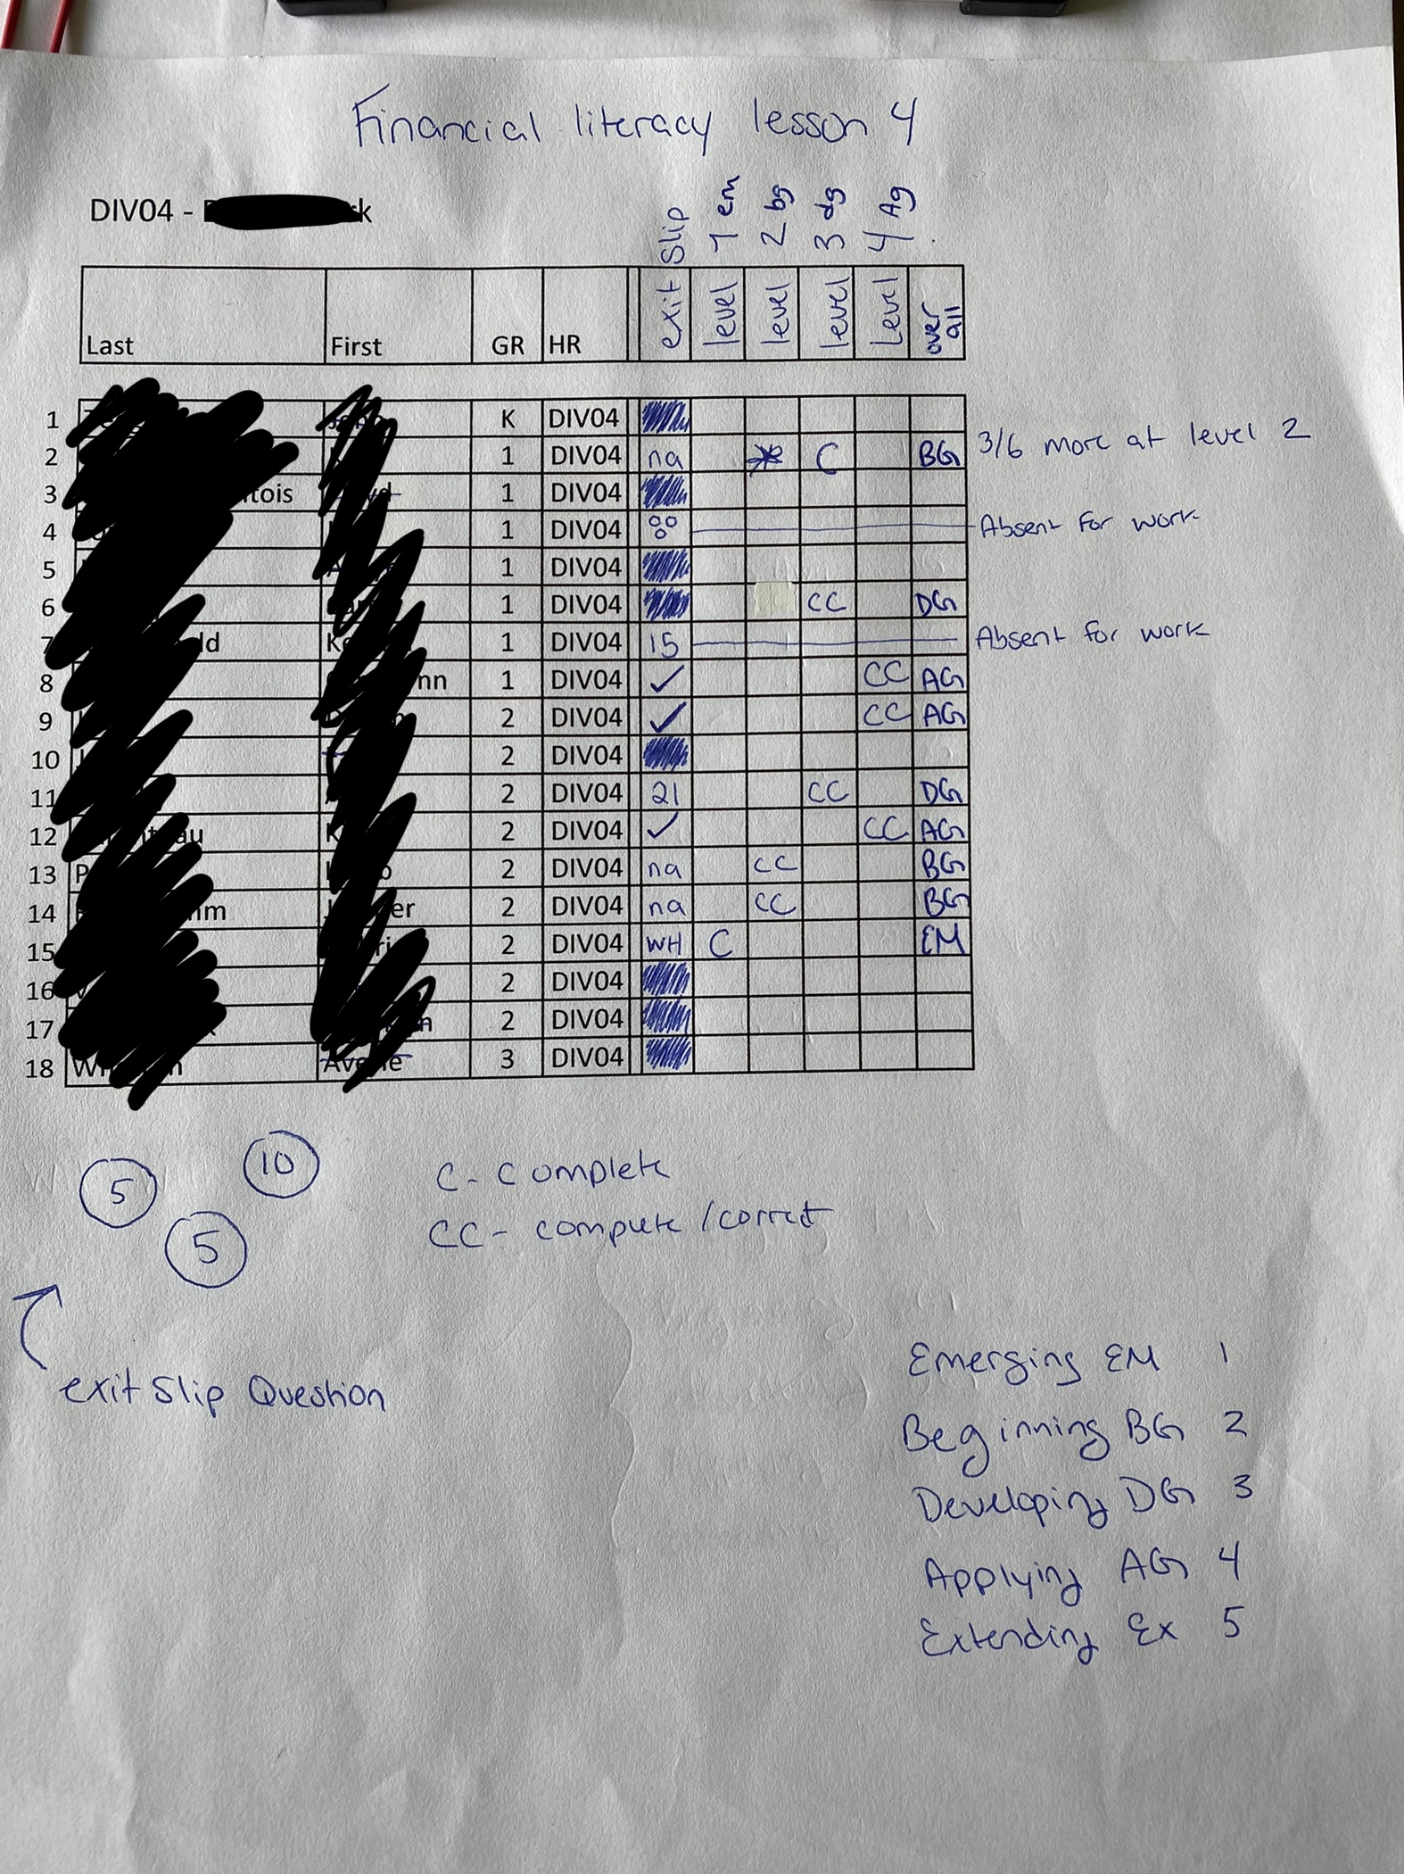
Practicing
Assessments
During both my practicums, I learned the helpful tip of using classroom lists as quick formative or summative assessment sheets.
I often found it difficult to find time to jot notes down during student learning and work periods- I now carry around a clipboard with a class list so that I can make notes!

Slide 6
Inclusivity and UDL
Something I really value as an educator is classroom inclusivity, differentiated instruction and a universal design for learning. I had a broad range of strengths in my 491 practicum and needed to adapt my teaching to meet my students needs. I realized the best way to do this was teach all students the same but change the work expectations and outcomes for each individual based off their strengths.
The next slide will include a breakthrough I had with a student who exceeded my expectations!

Slide 7
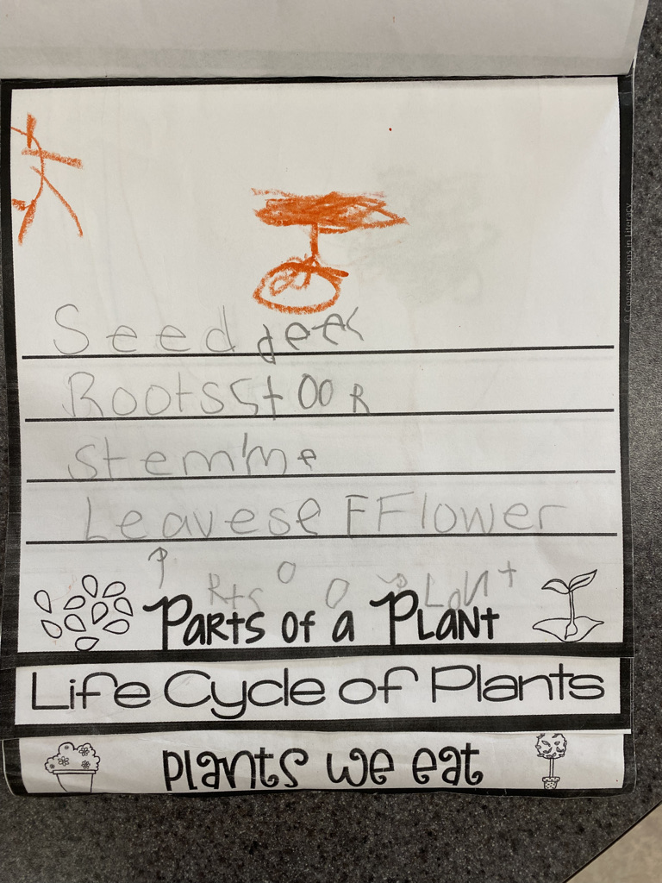

Slide 8
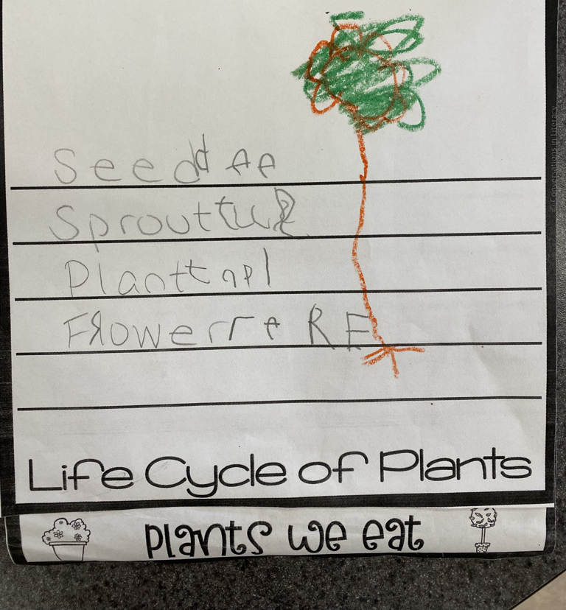
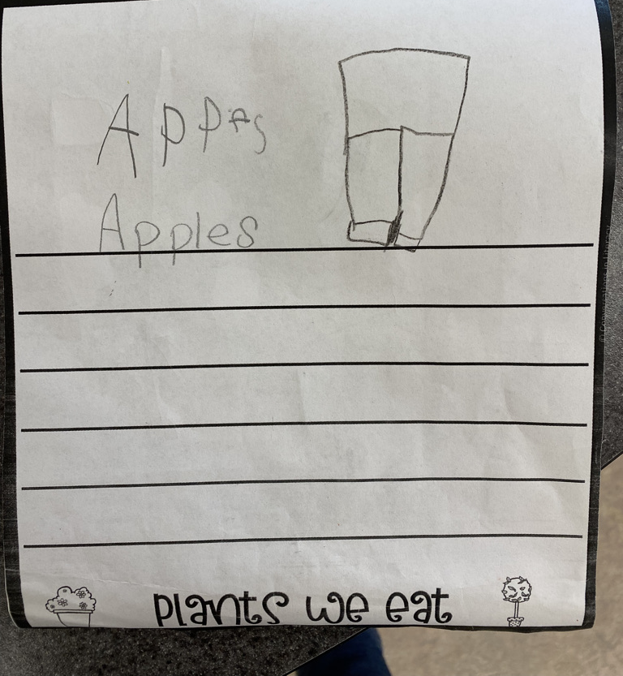
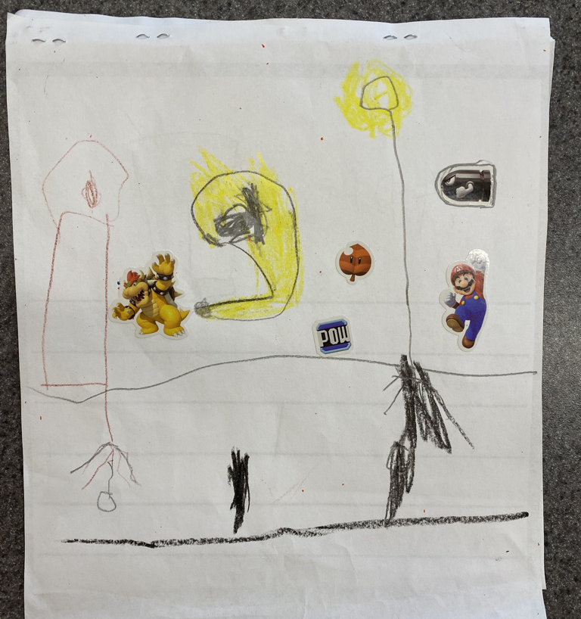
Student Success Exemplar
Celebration of learning and student growth

Slide 9
Musi Cho

