Slide 1
Capstone
Education 401 – Hannah Trombley

Slide 2
About me
Luu amhl good’y, my heart is happy
Hannah Catherine Trombley
Born and raised: Hazelton B.C
Gitxsan First Nation
Diploma: Kinesiology
Bachelor of Arts: English, Psychology
Teacher Candidate from the UNBC Education program
One word: Sensitive

Slide 3
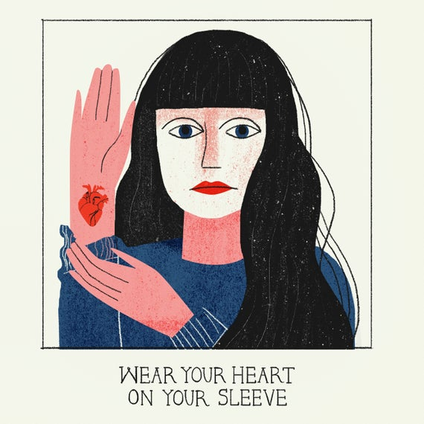
My Capstone
What I chose and Why
I chose the statement I wear my heart on my sleeve as a symbol for my capstone presentation
How this relates to me as an individual and educator
How this fits into career education and my practice (EDUC 401)
How this fits with diversity and diverse classrooms (EDUC 402)

Slide 4
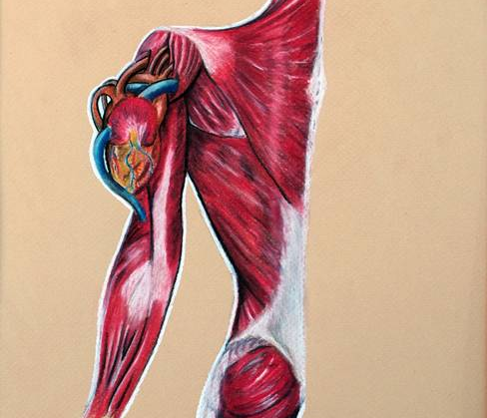
How I see myself
Holistic
Vulnerability
Authenticity
My family history
My character traits
My past experiences
My future plans
What I put in and what I get out = blood flow circulation
Understanding
Compassion
Empathy
Truth
Ambition

Slide 5
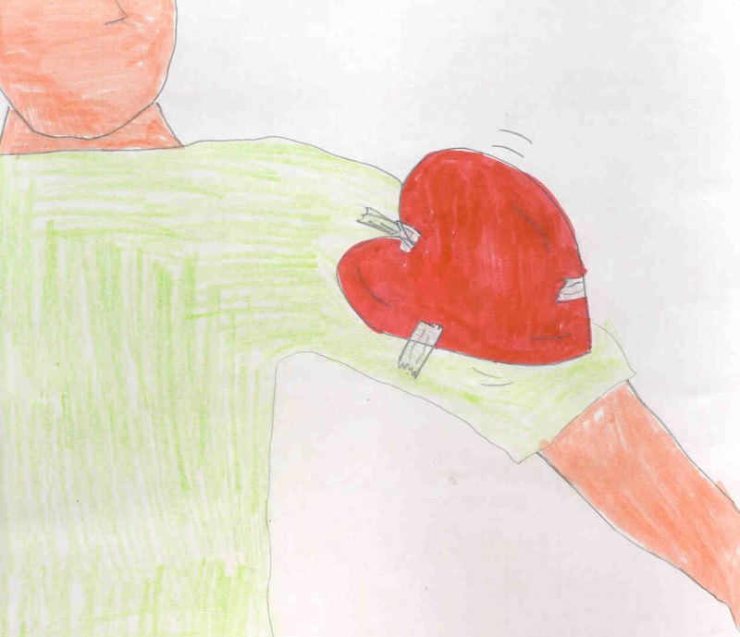
Career education
Change is constant – blood flow is constant
Beating of the heart symbolizes hope
Career mapping- vein mapping
Understanding your WHY
Every heart is physiologically the same, just like our human needs are the same – need for purpos

Slide 6
FPPL Learning is holistic, reflexive, reflective, experiential, and relational (focused on connectedness, on reciprocal relationships and a sense of place)

Slide 7
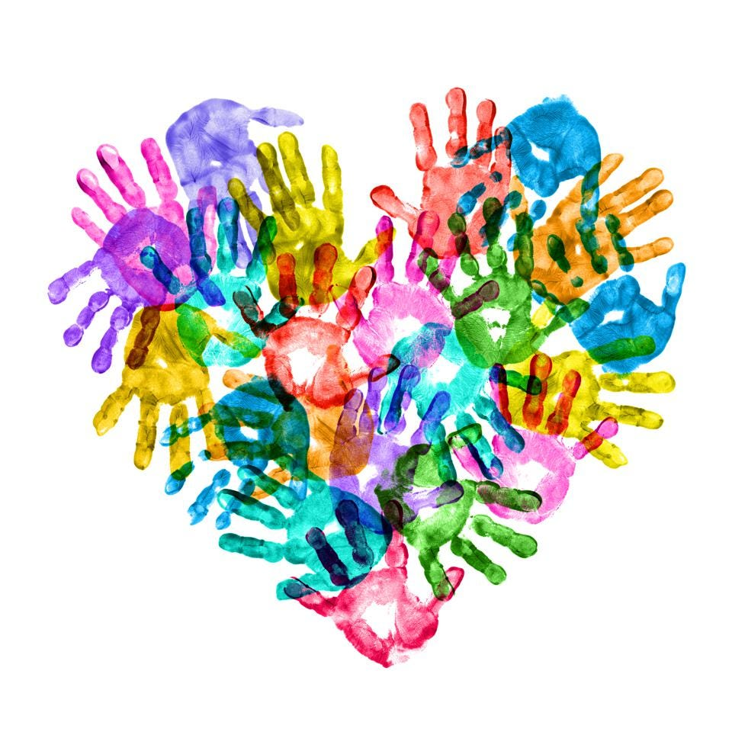
Diversity & Diverse Classrooms
Following your heart
Following your passions
Having an open heart
Diversity = empathy
Equality means each individual or group of people is given the same resources or opportunities. Equity recognizes that each person has different circumstances and allocates the exact resources and opportunities needed to reach an equal outcome.

Slide 8
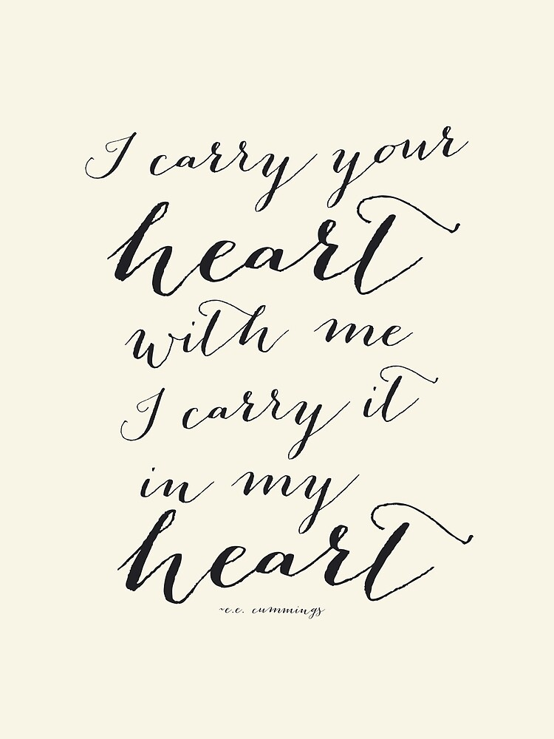
t’ooyaxs’y ‘niin
I thank you all

